Slide 1
Uniprocessor Scheduling
Chapter 9

Slide 2
Aim of Scheduling
Assign processes to be executed by the processor(s)
Scheduling Criteria(准则)
  Response time(响应时间)
  Throughput (吞吐量)
  Processor efficiency

Slide 3
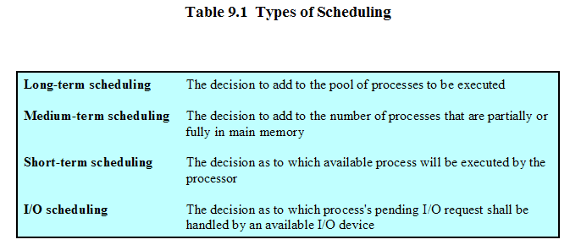
Types of Scheduling

Slide 4
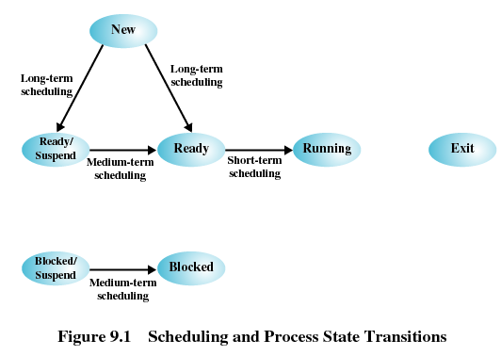
Scheduling and Process State Transitions

Slide 5
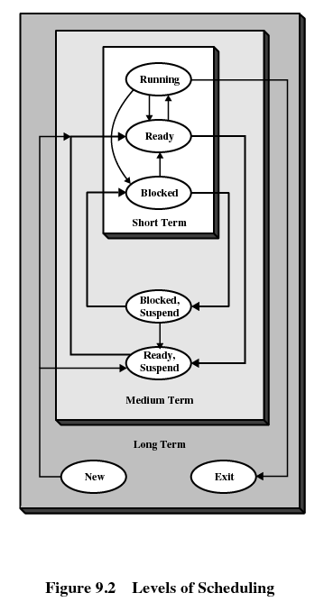
Levels of Scheduling

Slide 6
Long-Term Scheduling
Determines which programs are admitted to the system for processing
Controls the degree of multiprogramming
More processes, smaller percentage of time each process is executed

Slide 7
Medium-Term Scheduling
Part of the swapping function
Based on the need to manage the degree of multiprogramming

Slide 8
Short-Term Scheduling
Known as the dispatcher
Executes most frequently
Invoked when an event occurs
  Clock interrupts
  I/O interrupts
  Operating system calls
  Signals

Slide 9
Short-Tem Scheduling Criteria
User-oriented
  Response Time
    Elapsed time between the submission of a request until there is output.
System-oriented
  Effective and efficient utilization of the processor
Performance-related
  Quantitative
  Measurable such as response time and throughput

Slide 10
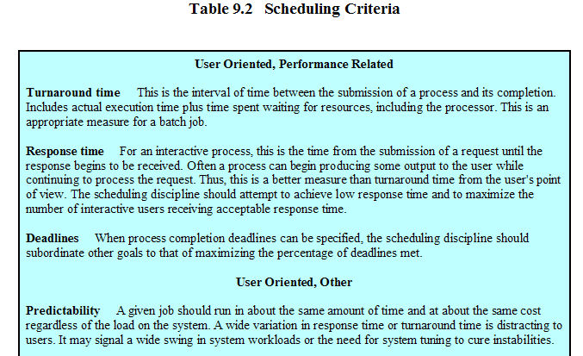
Scheduling Criteria

Slide 11
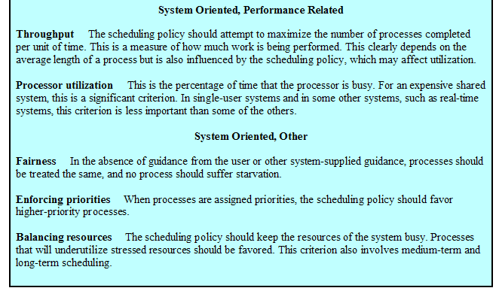
Scheduling Criteria (Cont.)

Slide 12
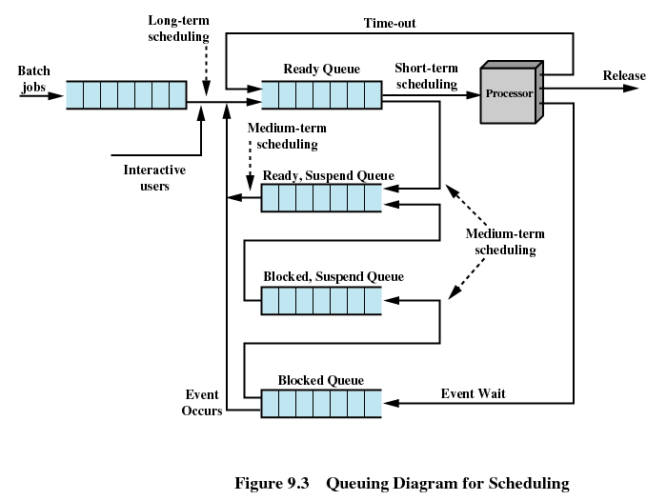
Queues for Scheduling

Slide 13
Priorities
Scheduler will always choose a process of higher priority over one of lower priority
Have multiple ready queues to represent each level of priority
Lower-priority may suffer starvation(饥饿)
  Allow a process to change its priority based on its age or execution history

Slide 14
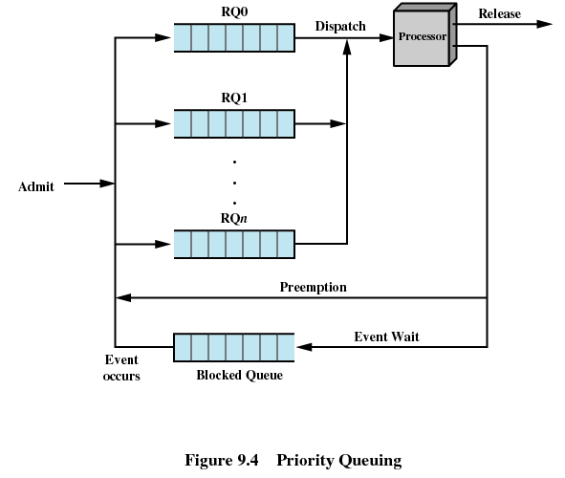
Priority Queuing

Slide 15
Decision Mode
Nonpreemptive
  Once a process is in the running state, it will continue until it terminates or blocks itself for I/O
Preemptive
  Currently running process may be interrupted and moved to the Ready state by the operating system
  Allows for better service since any one process cannot monopolize the processor for very long

Slide 16
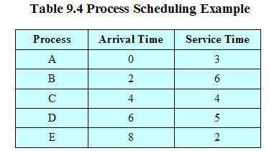
Process Scheduling Example

Slide 17
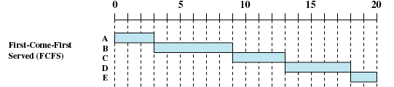
First-Come-First-Served (FCFS)
Each process joins the Ready queue
When the current process ceases to execute, the oldest process in the Ready queue is selected

Slide 18
First-Come-First-Served (Cont.)
A short process may have to wait a very long time before it can execute
Favors CPU-bound processes
  I/O processes have to wait until CPU-bound process completes

Slide 19


Round-Robin (RR)
Uses preemption based on a clock
An amount of time is determined that allows each process to use the processor for that length of time

Slide 20
Round-Robin (Cont.)
Clock interrupt is generated at periodic intervals
When an interrupt occurs, the currently running process is placed in the read queue
  Next ready job is selected
Known as time slicing

Slide 21
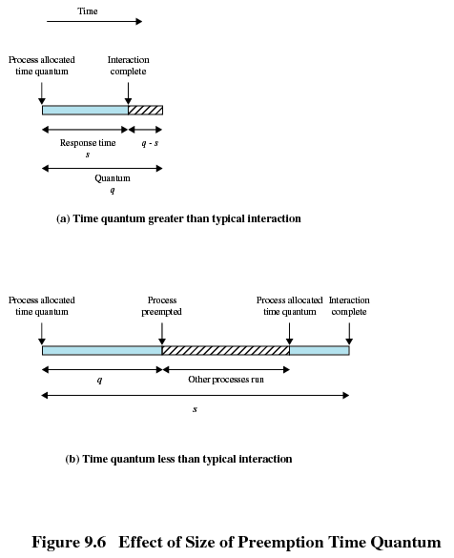
Preemption Time Quantum

Slide 22
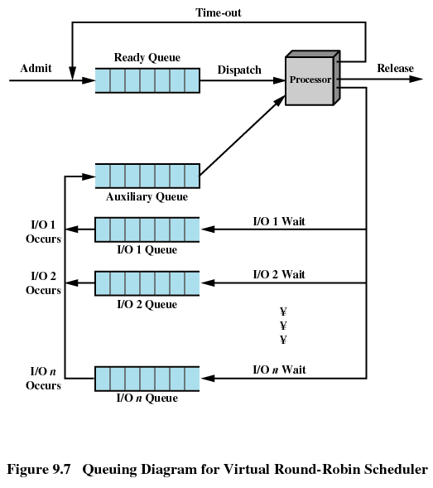
Virtual Round-Robin Scheduler
Drawback of RR
  CPU-bound
  I/O-bound
  Unfairness

Slide 23

Shortest Process Next
Nonpreemptive policy
Process with shortest expected processing time is selected next
Short process jumps ahead of longer processes

Slide 24
Shortest Process Next (Cont.)
Predictability of longer processes is reduced
If estimated time for process not correct, the operating system may abort it
Possibility of starvation for longer processes

Slide 25

Shortest Remaining Time
Preemptive version of shortest process next policy
Must estimate processing time

Slide 26

Highest Response Ratio Next (HRRN)
Choose next process with the greatest ratio
time spent waiting + expected service time
expected service time

Slide 27
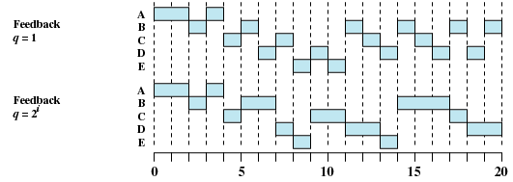
Feedback
Penalize jobs that have been running longer
Don’t know remaining time process needs to execute

Slide 28
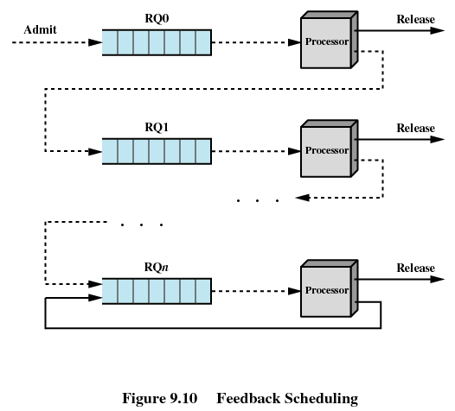
Feedback (Cont.)

Slide 29
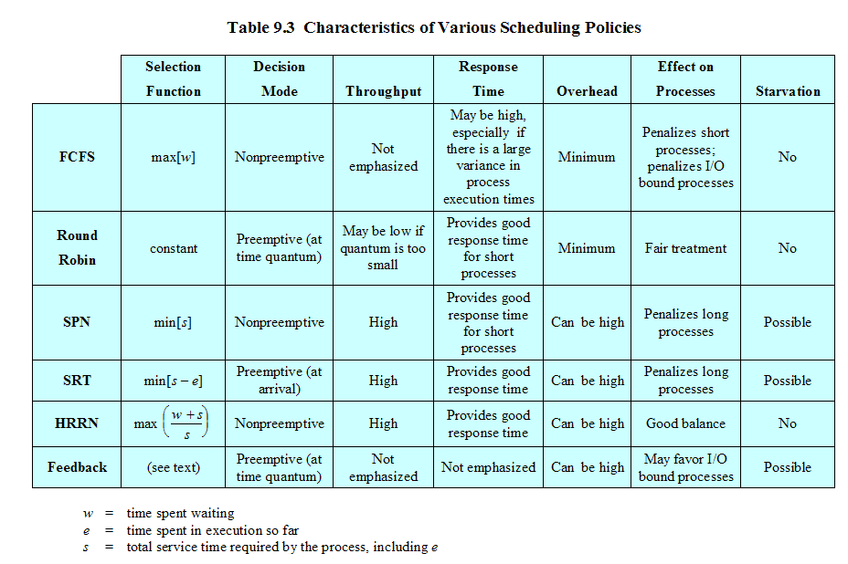
Characteristics of Various Policies

Slide 30
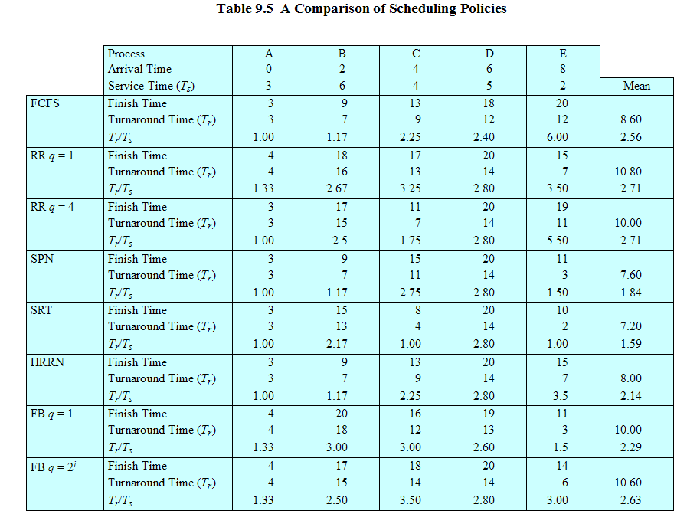
Comparison of Scheduling Policies

Slide 31
Traditional UNIX Scheduling
Multilevel feedback using round robin within each of the priority queues
If a running process does not block or complete within 1 second, it is preempted
Priorities are recomputed once per second
Base priority divides all processes into fixed bands of priority levels

Slide 32
Bands
Decreasing order of priority
  Swapper
  Block I/O device control
  File manipulation
  Character I/O device control
  User processes

Slide 33
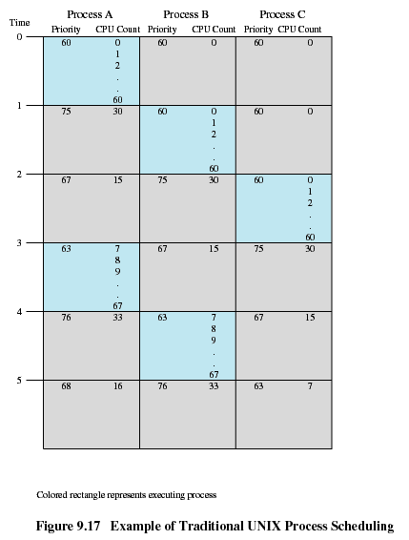
Traditional UNIX Scheduling

